Slide 1
Blind estimation of acoustic transfer functions (ATFs) and dereverberation based on convolutive transfer functions (CTFs) Date：2024. 06. 05
Telecom Electroacoustics Audio(TEA) Lab
Presenter:
Anchi Yuan
Notes:
Hello everyone
I’m today’s presenter siang. I’m going to share some of my present work in source separation problem. My topic is comparative studies of source separation using semi-blind and blind source separation approaches.

Slide 2
Outline
Experiment setting picture
Experiment setting
Experiment result

Slide 3
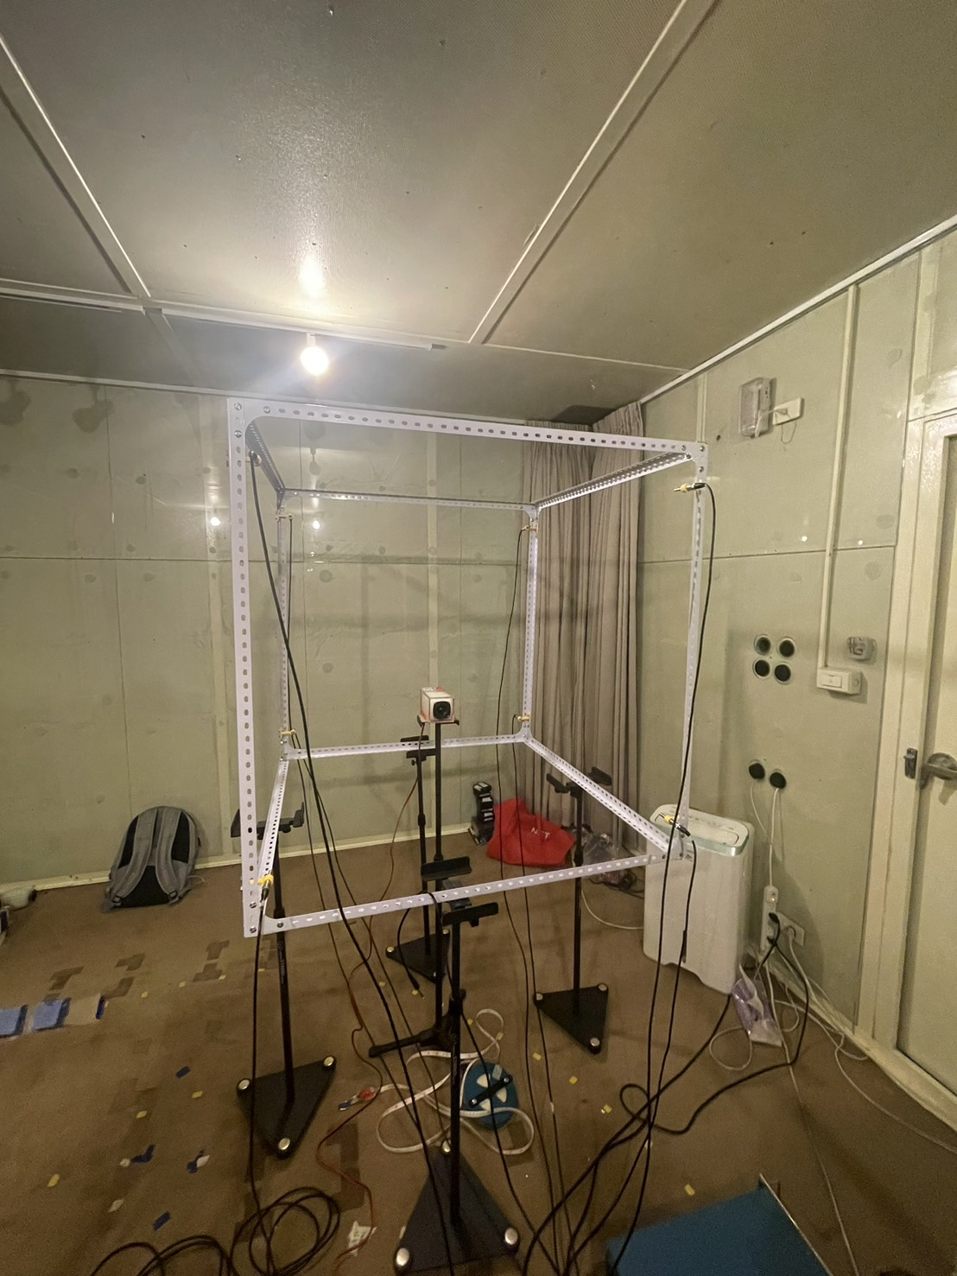
Experiment setting picture

Slide 4
Experiment setting
Experiment place : listening room
Measured reverberation time T₆₀ = 0.12s
Array type : distributed array
Number of microphones = 8
Sampling frequency = 48kHz
Source type : white noise

Slide 5
Experiment result

Slide 6
Experiment result

Slide 7
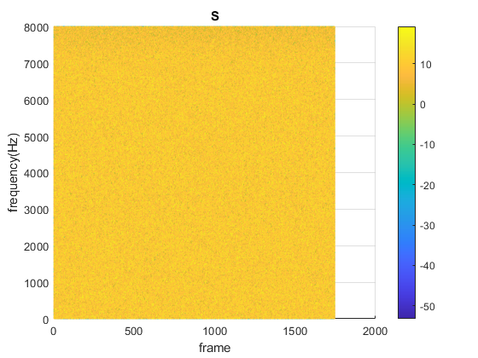
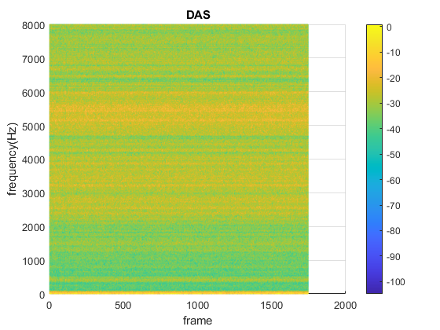
Experiment result

Slide 8
